Slide 1






Repository Manager
Using Artifactory
Copyright © 2017 Tech Mahindra. All rights reserved.
1

Slide 2



TABLE OF CONTENT
What is Repository Manager
What is Artifactory
Types of repositories
Artifactory and Hudson/Jenkins
Advanced Repository features
Bamboo task configuration for Artifactory
Artifactory repository browser for artifacts
Build browser
History for Builds
File upload into Artifactory-Single and Bulk deploy

Slide 3
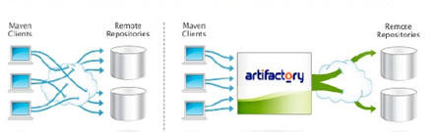
What is Repository Manager?
Artifacts storage and proxy
Avoid hitting public remote repositories
Inefficient, unreliable, content quality, insecure…
Deploy, manage and share local artifacts
Full control over artifacts resolution and Delivery

Slide 4
What is Artifactory?
Advanced Binaries repository-the binary’s SCM
JavaFX and WebStart repository
Supports REST ,Maven , Gradle , Ivy/Ant , Builder
Upload through UI, Indexed searches…

Slide 5

Configuration Tips
Remote repositories sharing via REST API
Reuse Configuration
Automatically generate the client configuration
Maven-settings.xml
Gradle plug-in
Centrally controlled encrypted password

Slide 6
Types of repositories
Local Repository
Local repositories are physical, locally-managed repositories into which you can deploy artifacts.
Artifacts in a local repository can be accessed directly using the following URL: http://<host>:<port>/artifactory/<local-repository-name>/<artifact-path>
Artifactory is deployed with a number of pre-configured local repositories which can be used for internal and external releases, snapshots and plugins.

Slide 7
Remote Repositories
A remote repository serves as a caching proxy for a repository managed at a remote URL (which may itself be another Artifactory remote repository).
Artifacts are stored and updated in remote repositories according to various configuration parameters that control the caching and proxying behavior. You can remove artifacts from a remote repository cache but you cannot actually deploy a new artifact into a remote repository.
Artifacts in a remote repository can be accessed directly using the following URL:
http://<host>:<port>/artifactory/<remote-repository-name>/<artifact-path>
This URL will fetch a remote artifact to the cache if it has not yet been stored.
In some cases it is useful to directly access artifacts that are already stored in the cache (for example to avoid remote update checks).
To directly access artifacts that are already stored in the cache you can use the following URL:
http://<host>:<port>/artifactory/<remote-repository-name>-cache/<artifact-path>
Artifactory is deployed with a number of pre-configured, remote repositories which are in common use. Of course you can change these according to the needs of your organization.

Slide 8
Proxy vs. Mirror
A remote repository acts as a proxy not as a mirror. Artifacts are not pre-fetched to a remote repository cache. They are only fetched and stored on demand when requested by a client. Therefore, a remote repository should not contain any artifacts in its cache immediately after creation. Artifacts will only be fetched to the cache once clients start working with the remote repository and issuing requests.

Slide 9
Virtual Repositories
A virtual repository (or "repository group") aggregates several repositories with the same package type under a common URL. The repository is virtual in that you can resolve and retrieve artifacts from it but you cannot deploy artifacts to it.

Slide 10
Searches
Search Types
Quick Search
GAVC
Properties
Class/Jar resource
See the actual class found
View source + syntax highlighting
Grouping Support
E.g. group by repository, groupID etc.
Always possible to locate the results in repo tree browser

Slide 11
Reproducible Builds
Source has reproducible context-compilation
Reproducible via SCM tagging
Binaries also have a context-packaging and publishing
A lot of thing are solved at build time
Version ranges
Dynamic properties value
Latest snapshot and releases

Slide 12

Artifactory and Hudson/Jenkins
Deploy from Hudson or artifactory
Navigate the builds in Artifactory
Link back to Hudson Builds
Relate artifacts to build
Export/promote/manipulate build artifacts
More efficient multi module deployment

Slide 13
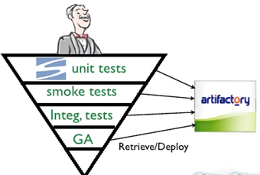
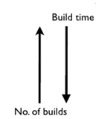
The Build Jobs Pyramid
SCM update
Retrieve
Test
Deploy

Slide 14
Advanced Repository features
Checksum-based storage
Handling download bursts
Verifying uploaded artifacts
Locking
Clean-up bad remote repo references
Built-in metadata

Slide 15
Checksum based storage
Many identical artifacts are produced and stored numerous times in the repositories
Unique snapshots that are exactly the same between subsequent builds
Other artifacts that are copied
Mainly needed for natural security control
Artifactory uses a Checksum based storage
Identical artifacts are stored on the server exactly once
Copy and move are very cheap

Slide 16
Concurrent Downloads/request bursts
New snapshot dependency available/POM updated with a new dependency version
Dependency can be as big as hundreds of megs
Assemblies
All clients download at once
Artifactory will identify this
Queue all incoming requests
Others will get the cached version

Slide 17
Checksum for uploaded artifacts
No way to verify uploaded artifacts
Maven approach:
The repository is passive
All calculation done on client
Repository to accept and store client checksum
Artifactory
Compare client checksum with the one calculated with the repository
If in conflict return 409 until a good checksum is found
This behavior is configurable

Slide 18
POM Cleanup
Many common third party POMs contains remote repository references making controlled resolution a nightmare
Global mirroring is not a solution
Forces a unified repository for releases/snapshots/plugins
Artifactory can façade POMs through a virtual Repository
Can configure a remote repo referenced to be removed
Original POM is intact

Slide 19
Smart staging and promotion
Repository has two main roles:
Proxy remote artifacts
Host deployed artifacts
Artifact should come from CI server
Promotion of artifacts start with build
The binaries repository and the CI server are always interconnected

Slide 20
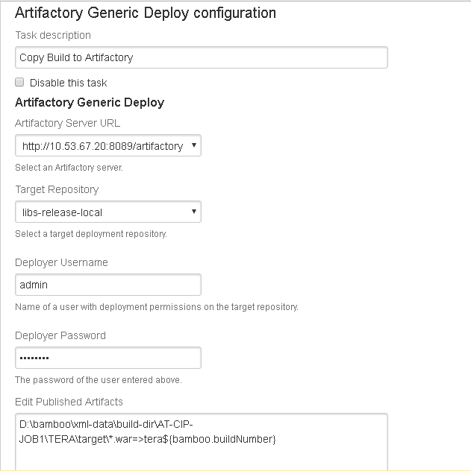
Artifacts can also be uploaded into Artifactory Using Continuous Intgration tool(Bamboo) as show below:

Slide 21
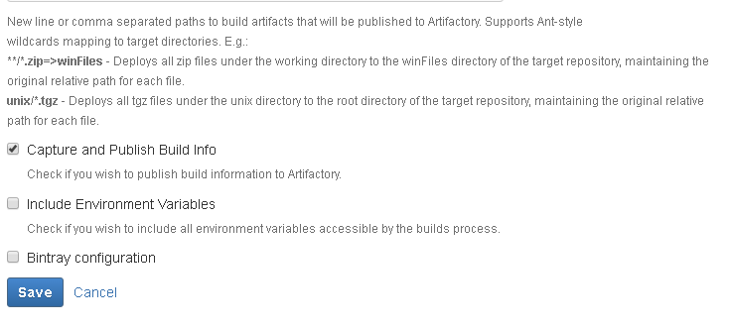
Above configuration is for the Continuous Integration tool called Bamboo

Slide 22
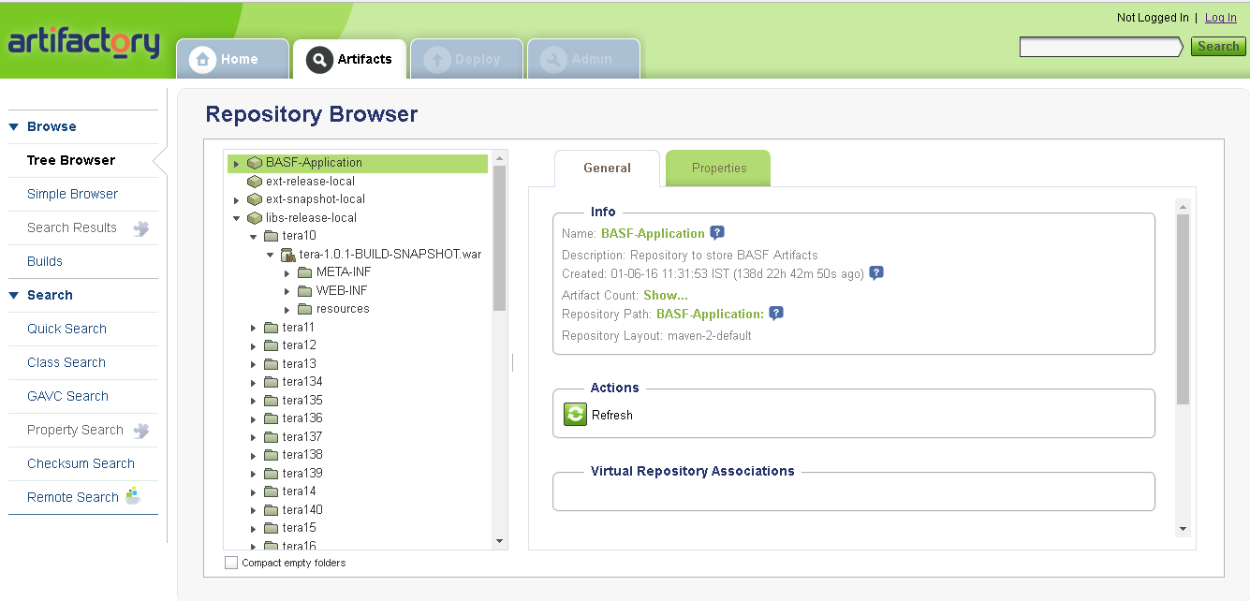
Once It is configured with the CI tool, we will be able to see the artifacts in Artifactory as shown below:

Slide 23
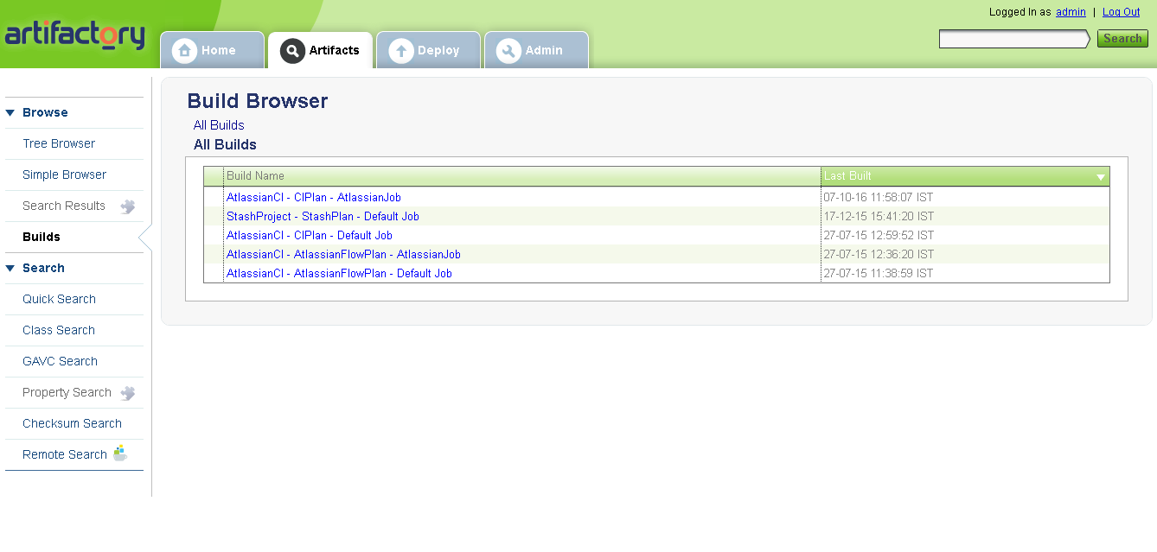
We can also see which build traceability as shown below:

Slide 24
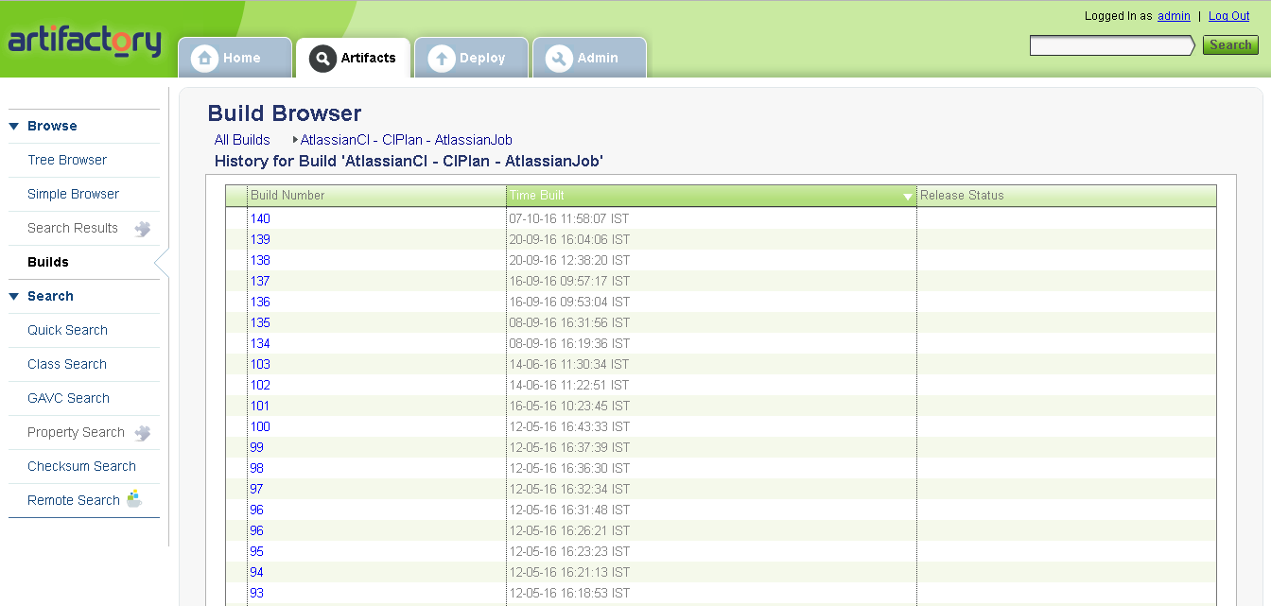

Slide 25
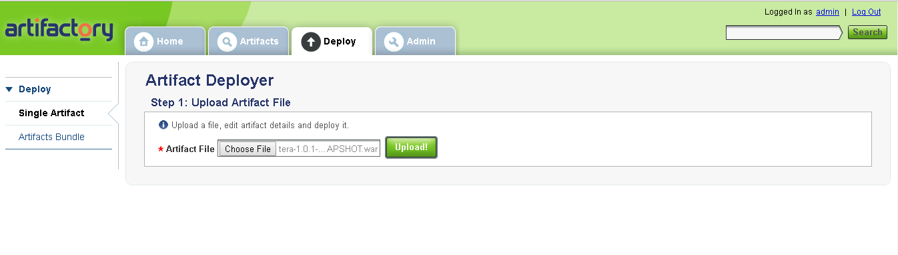
We can also upload artifacts into artifactory manually.
We can upload single artifact or bulk upload them.

Slide 26
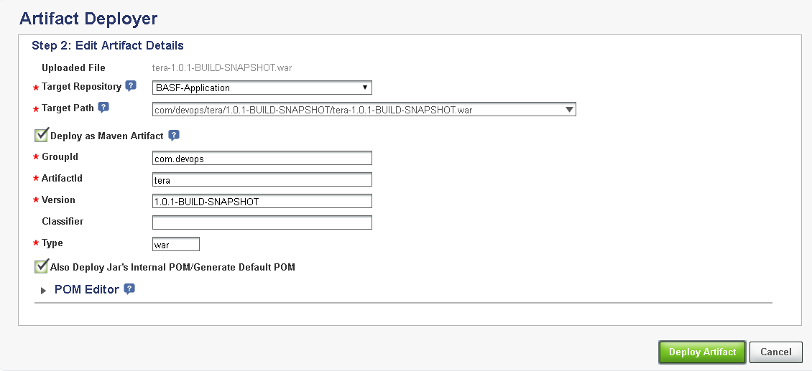

Slide 27
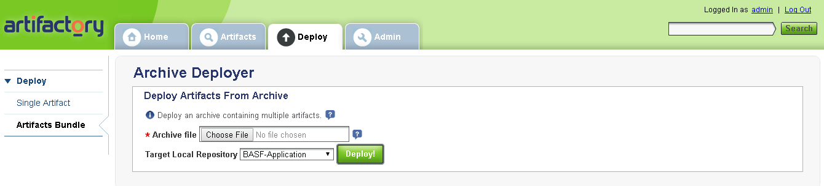
Hence, the artifact gets uploaded.
Bulk upload can be done manually as shown below:

Slide 28
Thank you
Visit us at www.techmahindra.com

